Slide 1
UPPER SIXTH ARTS
GEOGRAPHY
Map Analysis 4
Drainage on Maps
Notes:
Good morning, class, and welcome to our geography lesson. I am your geography teacher, Mr Kamdem. Today we are starting Map Analysis 4: Drainage on Maps.

Slide 2
CLASS INFO
Class, Chapter and Duration
Class | Upper Sixth Arts
Chapter | Module 8: Understanding and carrying out statistical techniques, topographic map analysis, fieldwork and project based learning
Duration | 2 periods (2 × 50 minutes)
Notes:
This lesson is for Upper Sixth Arts. It belongs to Module 8: Understanding and carrying out statistical techniques, topographic map analysis, fieldwork and project based learning. We shall need 2 periods to cover it.

Slide 3
IDENTIFICATION
Lesson Identification
Topic | Topographic Map Analysis
Sub-topic | Hydrological Analysis
Lesson | Map Analysis 4: Drainage on Maps
Notions / Concepts | Stream order, Strahler, bifurcation ratio, drainage density, stream frequency, sinuosity, drainage pattern.
Syllabus focus | Stream ordering (Strahler) and bifurcation ratio; drainage density and stream frequency; sinuosity; stream patterns; description of drainage.
Competence | Learners are able to order streams, calculate drainage indices and identify drainage patterns on a map.
Notes:
Our topic is Topographic Map Analysis, and the sub-topic is Hydrological Analysis. The key notions we shall use today are: stream order, Strahler, bifurcation ratio, drainage density, stream frequency, sinuosity, drainage pattern. At the end, you should be able to do this: learners are able to order streams, calculate drainage indices and identify drainage patterns on a map.

Slide 4

HOMEWORK CORRECTION
Correction of the Homework
Question (Map Analysis 3: Relief on Maps):
Draw the cross-section X–Y from the extract and label the landforms.
Notes:
Before we start the new lesson, let us correct the homework I gave you at the end of Map Analysis 3: Relief on Maps. The question was: Draw the cross-section X–Y from the extract and label the landforms. Take out your exercise books.

Slide 5
HOMEWORK CORRECTION
Correction: Possible Answer
Mark the contours crossed by X–Y on a paper strip, transfer them to a graph (horizontal scale = map scale, vertical scale exaggerated), join the points smoothly and label the hill, the valley and the river.
Notes:
Here is a good answer. Mark the contours crossed by X–Y on a paper strip, transfer them to a graph (horizontal scale = map scale, vertical scale exaggerated), join the points smoothly and label the hill, the valley and the river. Compare it with your own answer and correct your work in red.

Slide 6
LESSON PLAN
Lesson Plan
Correction of the homework
Objectives and recall
Real-life situation and action to take
Learning activities
Board summary
Evaluation, remediation and homework
Notes:
Here is the plan of our lesson today. First, we shall correct the homework. Then we shall look at the objectives and recall what you already know. After that, we shall study a situation from real life and the action to take, and do the learning activities. Finally, we shall copy the board summary, do the evaluation and the remediation, and I will give you the homework.

Slide 7
OBJECTIVES
Objectives
By the end of this lesson, you should be able to:
Order streams using Strahler's method.
Calculate the bifurcation ratio, drainage density and sinuosity.
Identify and explain drainage patterns.
Notes:
By the end of this lesson, you should be able to do three things. Number 1: order streams using Strahler's method. Number 2: calculate the bifurcation ratio, drainage density and sinuosity. Number 3: identify and explain drainage patterns.

Slide 8
PREVIOUS KNOWLEDGE
Previous Knowledge
Small streams join to form rivers.
A drainage basin is the area drained by a river.
Notes:
Let us first remember what you already know. Small streams join to form rivers. A drainage basin is the area drained by a river. Keep this in mind, because we shall build on it today.

Slide 9
REAL-LIFE SITUATION
Situation in Real Life
The Benue basin floods often. An engineer asks the class to study a map of a small basin, order its streams and calculate indices to judge the flood risk.
Notes:
Listen carefully to this situation from real life. The Benue basin floods often. An engineer asks the class to study a map of a small basin, order its streams and calculate indices to judge the flood risk. Think about it, because I am going to ask you some questions.

Slide 10
REAL-LIFE SITUATION
Situation: Question 1
What is the problem in the situation?
Notes:
Question 1: What is the problem in the situation? Think for a moment, then raise your hand to answer.

Slide 11
REAL-LIFE SITUATION
Answer
The class must assess flood risk from the drainage.
Notes:
Good. The class must assess flood risk from the drainage.

Slide 12
REAL-LIFE SITUATION
Situation: Question 2
Which method orders streams?
Notes:
Question 2: Which method orders streams? Think for a moment, then raise your hand to answer.

Slide 13
REAL-LIFE SITUATION
Answer
Strahler's method.
Notes:
Good. Strahler's method.

Slide 14
REAL-LIFE SITUATION
Situation: Question 3
Which index is linked to flood risk?
Notes:
Question 3: Which index is linked to flood risk? Think for a moment, then raise your hand to answer.

Slide 15
REAL-LIFE SITUATION
Possible Answer
The bifurcation ratio (also drainage density).
Notes:
Good. The bifurcation ratio (also drainage density).

Slide 16
ACTION TO TAKE
Action to Take
Measure drainage with numbers, not only with words.
Notes:
From this situation, the action we are working towards in this lesson is the following: measure drainage with numbers, not only with words.

Slide 17
JUSTIFICATION
Justification of the Lesson
This lesson helps us to analyse rivers and flood risk from maps.
Notes:
Why is this lesson important for you? This lesson helps us to analyse rivers and flood risk from maps.

Slide 18
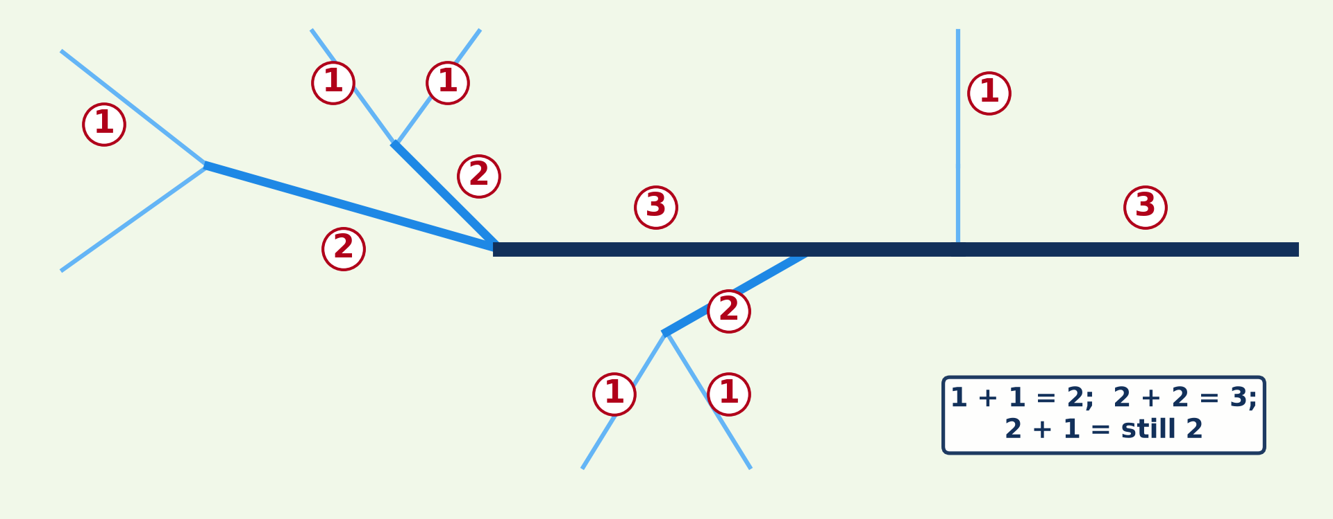
1. STREAM ORDER
Activity 1
Strahler stream ordering.
Notes:
Activity 1. Look carefully at this diagram: strahler stream ordering. Observe every detail before I ask the question.

Slide 19
1. STREAM ORDER
Activity 1: Question
What happens when two 2nd-order streams meet? And a 2nd and a 1st?
Notes:
Here is the question for Activity 1: What happens when two 2nd-order streams meet? And a 2nd and a 1st? Take one minute to think and write your answer in your rough notebook.

Slide 20
1. STREAM ORDER
Activity 1: Answer
They form a 3rd-order stream; 2 + 1 stays 2nd order.
Notes:
Let us check the answer together. They form a 3rd-order stream; 2 + 1 stays 2nd order.

Slide 21
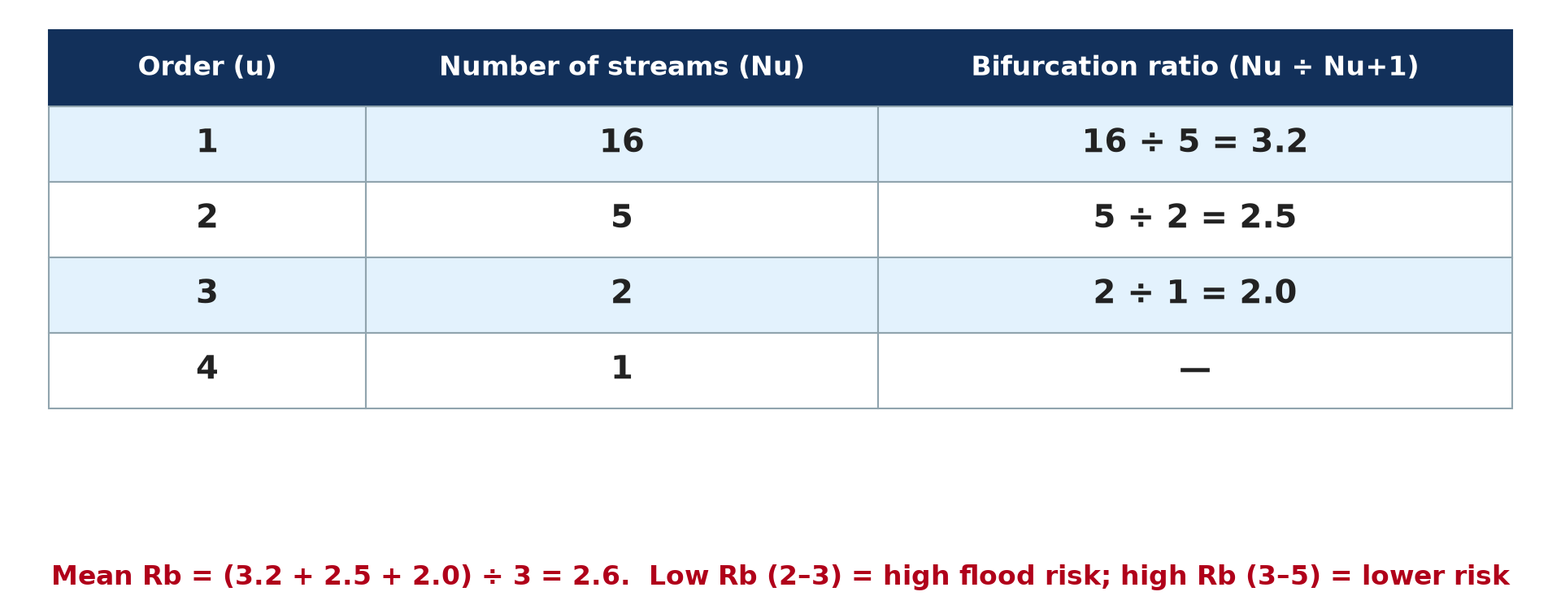
1. BIFURCATION RATIO
Activity 2
Bifurcation ratios.
Notes:
Activity 2. Look carefully at this diagram: bifurcation ratios. Observe every detail before I ask the question.

Slide 22
1. BIFURCATION RATIO
Activity 2: Question
Calculate Rb between orders 1 and 2 if there are 16 and 5 streams.
Notes:
Here is the question for Activity 2: Calculate Rb between orders 1 and 2 if there are 16 and 5 streams. Take one minute to think and write your answer in your rough notebook.

Slide 23
1. BIFURCATION RATIO
Activity 2: Answer
16 ÷ 5 = 3.2.
Notes:
Let us check the answer together. 16 ÷ 5 = 3.2.

Slide 24
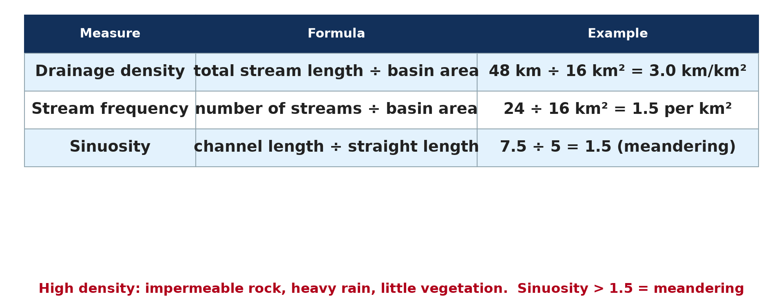
2. DENSITY AND SINUOSITY
Activity 3
Drainage calculations.
Notes:
Activity 3. Look carefully at this diagram: drainage calculations. Observe every detail before I ask the question.

Slide 25
2. DENSITY AND SINUOSITY
Activity 3: Question
A basin of 20 km² has 50 km of streams. Find the drainage density.
Notes:
Here is the question for Activity 3: A basin of 20 km² has 50 km of streams. Find the drainage density. Take one minute to think and write your answer in your rough notebook.

Slide 26
2. DENSITY AND SINUOSITY
Activity 3: Answer
50 ÷ 20 = 2.5 km per km².
Notes:
Let us check the answer together. 50 ÷ 20 = 2.5 km per km².

Slide 27
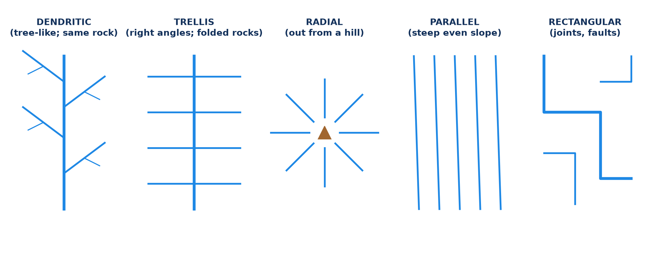
3. DRAINAGE PATTERNS
Activity 4
Drainage patterns.
Notes:
Activity 4. Look carefully at this diagram: drainage patterns. Observe every detail before I ask the question.

Slide 28
3. DRAINAGE PATTERNS
Activity 4: Question
Which pattern develops on uniform rock, and which around a volcano?
Notes:
Here is the question for Activity 4: Which pattern develops on uniform rock, and which around a volcano? Take one minute to think and write your answer in your rough notebook.

Slide 29
3. DRAINAGE PATTERNS
Activity 4: Answer
Dendritic on uniform rock; radial around a volcano.
Notes:
Let us check the answer together. Dendritic on uniform rock; radial around a volcano.

Slide 30

4. DESCRIPTION OF DRAINAGE
Activity 5
A map extract (invented).
Notes:
Activity 5. Look carefully at this diagram: a map extract (invented). Observe every detail before I ask the question.

Slide 31
4. DESCRIPTION OF DRAINAGE
Activity 5: Question
In which direction does the main river flow? Give evidence.
Notes:
Here is the question for Activity 5: In which direction does the main river flow? Give evidence. Take one minute to think and write your answer in your rough notebook.

Slide 32
4. DESCRIPTION OF DRAINAGE
Activity 5: Answer
It flows south from the northern edge, then east, from higher to lower contours.
Notes:
Let us check the answer together. It flows south from the northern edge, then east, from higher to lower contours.

Slide 33
BOARD SUMMARY
Board Summary
Topic: Topographic Map Analysis
Sub-topic: Hydrological Analysis
Map Analysis 4: Drainage on Maps
Notes:
Now we are going to copy the board summary. Write the title and the headings neatly in your notebooks. I will give you enough time for each slide, so do not rush.

Slide 34
BOARD SUMMARY
1. Stream Ordering and Bifurcation Ratio
Streams are ordered and compared as follows:
Strahler stream order: Source streams are 1st order, and two streams of the same order join to form the next order. A lower-order stream joining a higher one does not change its order.
Notes:
Let us copy Stream Ordering and Bifurcation Ratio. Streams are ordered and compared as follows. On this slide we have Strahler stream order. Write each point on a new line, with the key term first, and explain it in your own words when we revise. When you finish, we go to the next slide.

Slide 35
BOARD SUMMARY
1. Stream Ordering and Bifurcation Ratio (continued)
Bifurcation ratio: It is the number of streams of one order divided by the number of the next order (Rb = Nu ÷ Nu+1). A high ratio shows a well-branched basin with a low flood risk.
Notes:
We continue with Stream Ordering and Bifurcation Ratio. On this slide we have Bifurcation ratio. Write each point on a new line, with the key term first, and explain it in your own words when we revise.

Slide 36
BOARD SUMMARY
1. Stream Ordering and Bifurcation Ratio
Illustration: Strahler stream ordering
Notes:
Now draw this illustration in your notebook: strahler stream ordering. Give it a title and label it clearly.

Slide 37
BOARD SUMMARY
2. Drainage Density, Stream Frequency and Sinuosity
Drainage is measured with the following indices:
Drainage density: It is the total length of streams divided by the basin area (km per km²). It is high on impermeable rocks, steep slopes and bare land.
Notes:
Let us copy Drainage Density, Stream Frequency and Sinuosity. Drainage is measured with the following indices. On this slide we have Drainage density. Write each point on a new line, with the key term first, and explain it in your own words when we revise. When you finish, we go to the next slide.

Slide 38
BOARD SUMMARY
2. Drainage Density, Stream Frequency and Sinuosity (continued)
Stream frequency: It is the number of streams divided by the basin area. It shows how many channels drain the area.
Sinuosity: It is the channel length divided by the straight-line distance. A value above 1.5 shows a meandering river.
Notes:
We continue with Drainage Density, Stream Frequency and Sinuosity. On this slide we have Stream frequency and Sinuosity. Write each point on a new line, with the key term first, and explain it in your own words when we revise.

Slide 39
BOARD SUMMARY
2. Drainage Density, Stream Frequency and Sinuosity
Illustration: drainage calculations
Notes:
Now draw this illustration in your notebook: drainage calculations. Give it a title and label it clearly.

Slide 40
BOARD SUMMARY
3. Drainage Patterns and Description
Drainage is described as follows:
Drainage patterns: Dendritic patterns form on uniform rock and radial patterns around a volcano or dome. Trellis patterns form on alternating hard and soft rocks.
Notes:
Let us copy Drainage Patterns and Description. Drainage is described as follows. On this slide we have Drainage patterns. Write each point on a new line, with the key term first, and explain it in your own words when we revise. When you finish, we go to the next slide.

Slide 41
BOARD SUMMARY
3. Drainage Patterns and Description (continued)
Description: State the main river, its direction of flow and its tributaries with map evidence. Also describe the density, the pattern and features such as marshes and waterfalls.
Notes:
We continue with Drainage Patterns and Description. On this slide we have Description. Write each point on a new line, with the key term first, and explain it in your own words when we revise.

Slide 42
BOARD SUMMARY
3. Drainage Patterns and Description
Illustration: drainage patterns
Notes:
Now draw this illustration in your notebook: drainage patterns. Give it a title and label it clearly.

Slide 43
FORMATIVE EVALUATION
Evaluation 1
A basin has 12 first-order and 3 second-order streams. Find Rb.
Notes:
Now let us check what you have understood. Question 1: A basin has 12 first-order and 3 second-order streams. Find Rb. Answer in your exercise book.

Slide 44
FORMATIVE EVALUATION
Expected Answer
12 ÷ 3 = 4.0.
Notes:
The expected answer is: 12 ÷ 3 = 4.0. If you got it right, well done.

Slide 45
FORMATIVE EVALUATION
Evaluation 2
A river is 9 km long; the straight line is 6 km. Find sinuosity.
Notes:
Now let us check what you have understood. Question 2: A river is 9 km long; the straight line is 6 km. Find sinuosity. Answer in your exercise book.

Slide 46
FORMATIVE EVALUATION
Expected Answer
9 ÷ 6 = 1.5 (meandering).
Notes:
The expected answer is: 9 ÷ 6 = 1.5 (meandering). If you got it right, well done.

Slide 47
REMEDIATION
Remediation
Fill in the blanks:
Stream ordering method: ______.
Length of streams ÷ basin area = drainage ______.
A tree-like pattern is ______.
Notes:
For those who need more practice, fill in the blanks in your exercise book. The answers are: number 1, Strahler; number 2, density; number 3, dendritic.

Slide 48
HOMEWORK
Homework
Trace a river network from a map, order its streams and calculate the mean bifurcation ratio.
Notes:
For your homework: Trace a river network from a map, order its streams and calculate the mean bifurcation ratio. We shall correct it at the beginning of our next lesson.

Slide 49
NEXT LESSON
Next Lesson
Our next lesson will be on:
Map Analysis 5: Vegetation on Maps
Notes:
Our next lesson will be on Map Analysis 5: Vegetation on Maps. Thank you for your attention, and see you next time.

Slide 50
BILINGUAL GAME
Bilingual Game (Jeu Bilingue)
English | Français
Stream | Le cours d'eau
Tributary | L'affluent
Drainage basin | Le bassin versant
Pattern | Le réseau
Density | La densité
Meander | Le méandre
Notes:
Let us play the bilingual game. I say a word in English, and you give me the French word. Then we do the reverse.

Slide 51
LOGBOOK
Official Logbook (1/2)
Module / Topic | Topographic Map Analysis
Lesson Title | Map Analysis 4: Drainage on Maps
Expected Learning Outcomes | Order streams using Strahler's method. Calculate the bifurcation ratio, drainage density and sinuosity. Identify and explain drainage patterns.
Competence | Learners are able to order streams, calculate drainage indices and identify drainage patterns on a map.
Notes:
I record this information in the official logbook of the class after the lesson.

Slide 52
LOGBOOK
Official Logbook (2/2)
Matter Taught | Stream Ordering and Bifurcation Ratio; Drainage Density, Stream Frequency and Sinuosity; Drainage Patterns and Description.
Evaluation | Formative evaluation and remediation exercise.
Homework | Trace a river network from a map, order its streams and calculate the mean bifurcation ratio.
Enrolment / Present / Absent | ____ / ____ / ____
Achievement | To be completed after the lesson.
Notes:
I complete the second page of the logbook: the matter taught, the evaluation, the homework and the attendance.

Slide 53
TEACHER'S NOTE
Teacher's Note
Timing: Homework correction, plan, objectives 8 min | Recall, situation, action 10 min | 5 activities 30 min | Board summary (copying) 30 min | Evaluation, remediation 10 min | Homework, next lesson 5 min | Logbook 7 min
Without the projector (Activity 1): order a network.
Without the projector (Activity 2): calculate each ratio.
Without the projector (Activity 3): calculate density.
Without the projector (Activity 4): draw the patterns.
Without the projector (Activity 5): describe the drainage.
Notes:
This slide is for me, the teacher: it gives the timing of the lesson and what to do if the projector is not available.

Slide 54
REFERENCES
References
National Geography Syllabus, MINESEC/IGE/IP-SS, 2019 — Module 8 (Practical Geography).
Diagrams and animations: drawn for this lesson (Geography Department).
Notes:
These are the references and picture credits used to prepare this lesson.

